Slide 1


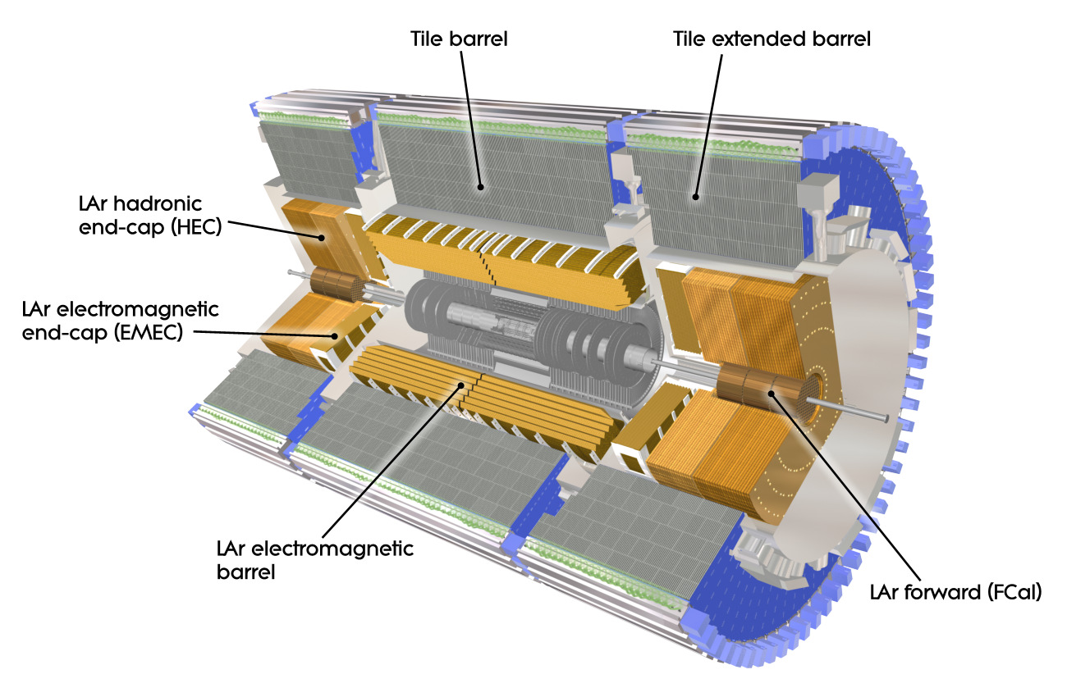
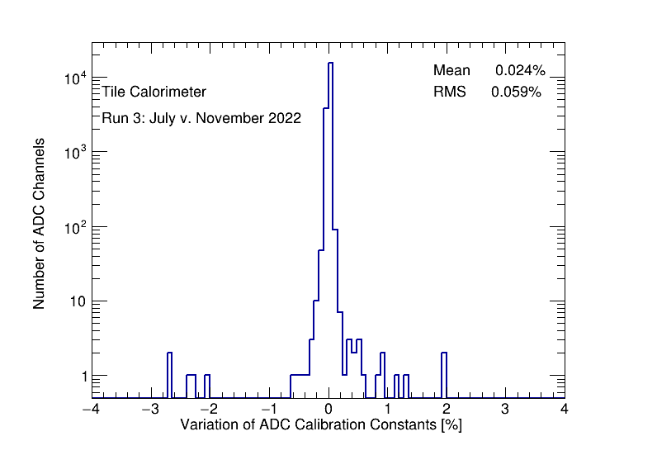
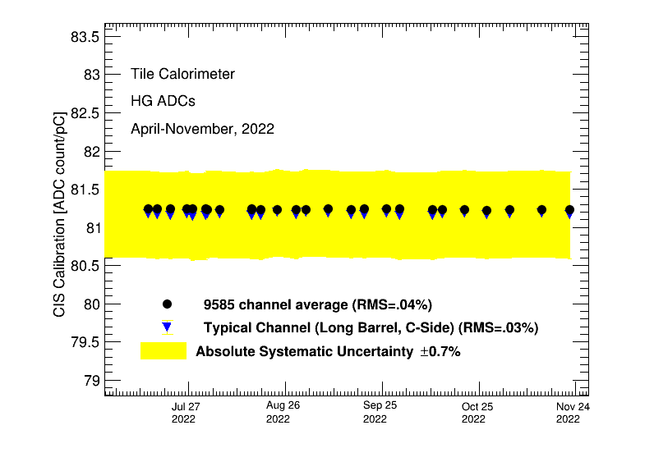
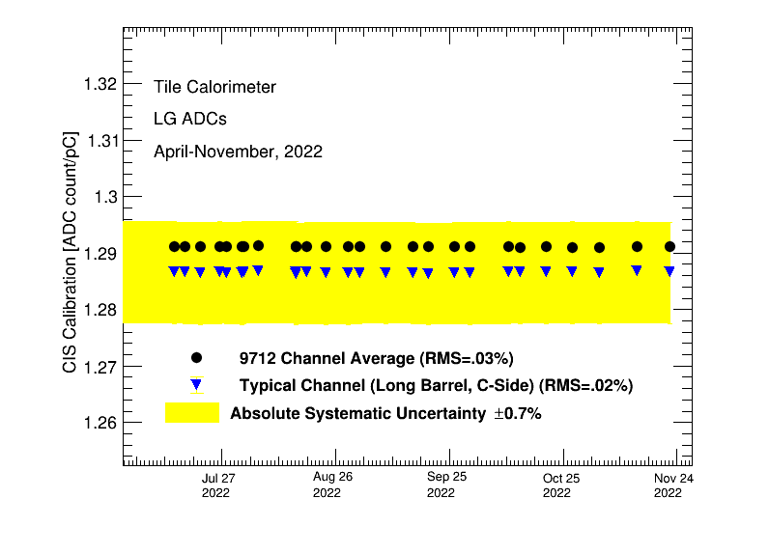
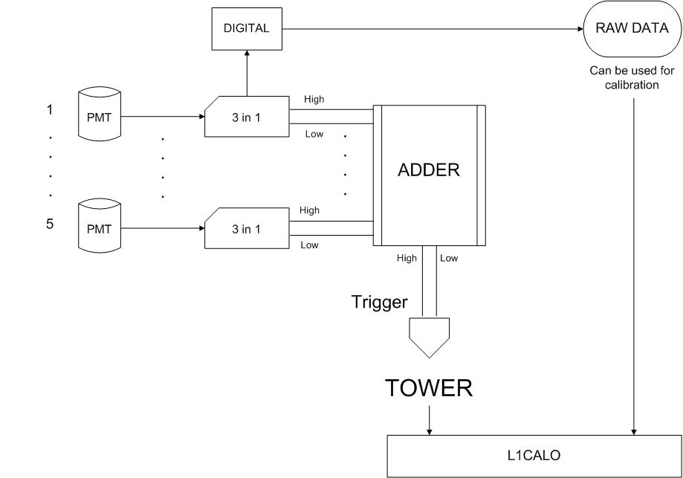
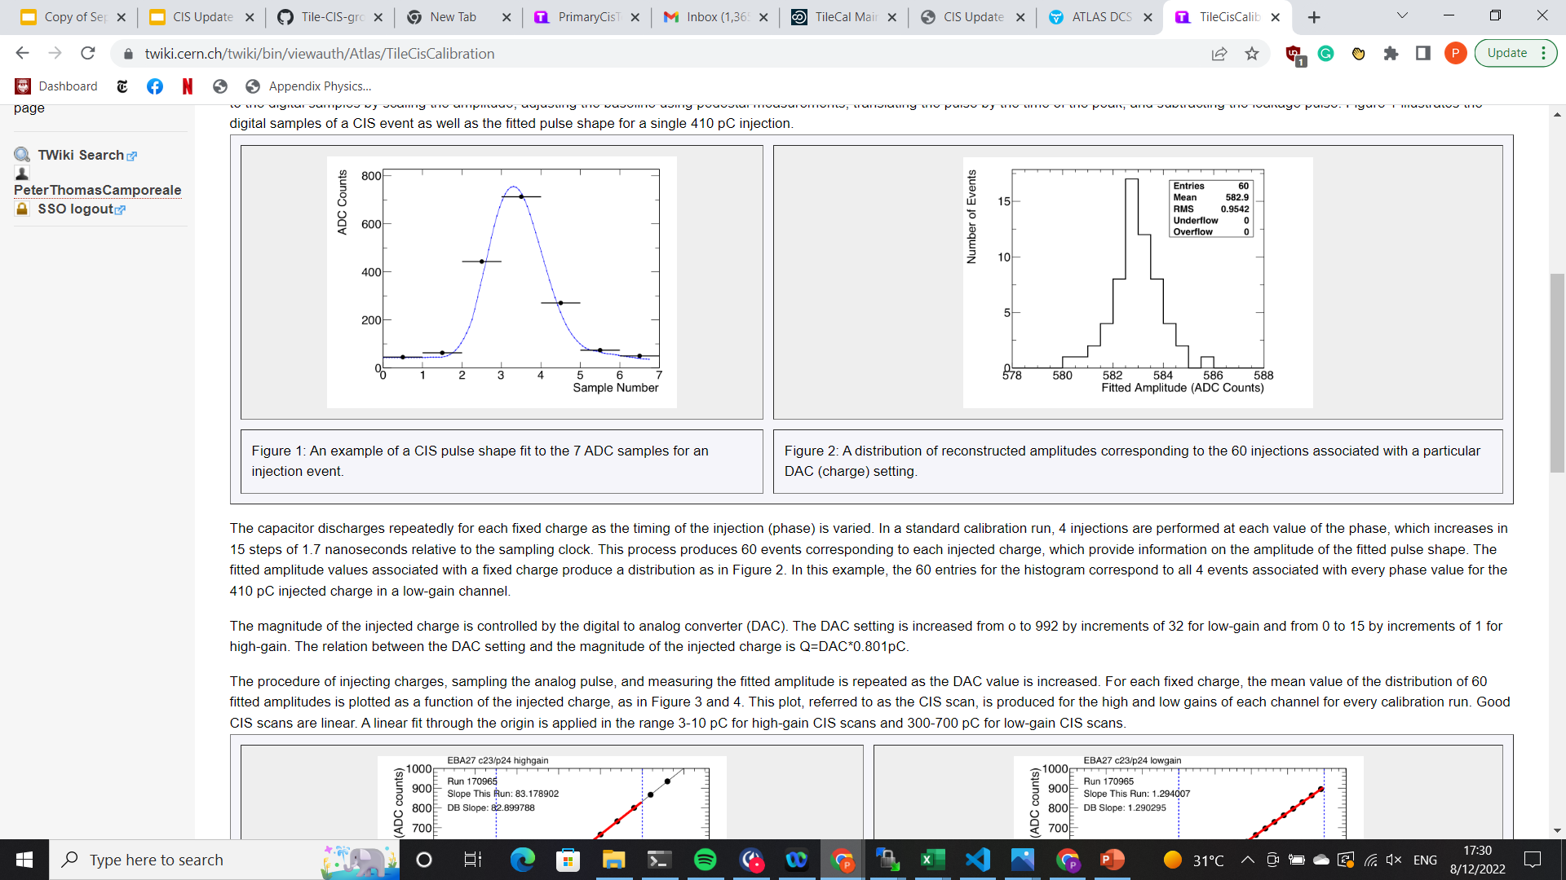
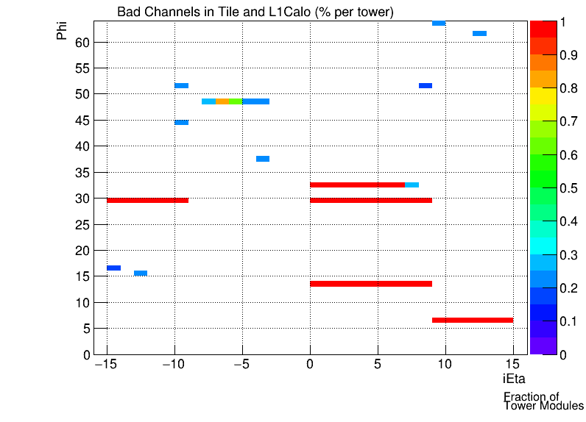
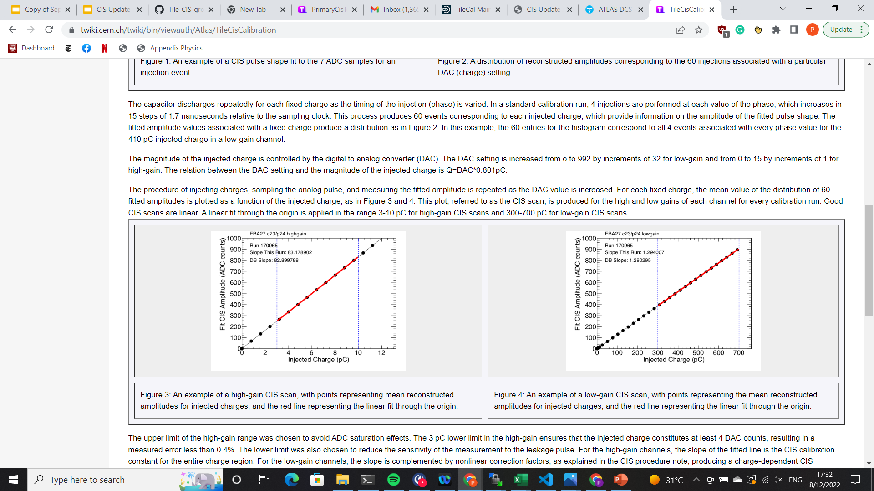
ATLAS Tile Calorimeter Charge Injection System (CIS) and L1Calo
Mengyang Li and Peter Camporeale of The University of Chicago
On ATLAS Week (Feb 13-17, 2023)
We define thresholds to characterize the response of PMTs compared
to our expectation given a known injected charge. The following are
the two types of bad channels: no gain (less than 10% response) and half gain (between 10% and 50% response). We compare these channels to those flagged by L1Calo through other calibrations.
CIS Constant Stability in Run 3
The charge injection system injects a pulse of known charge and records the output in ADC counts. After scanning a range of input charge, the results are used to derive the CCIS conversion factor, converting ADC counts to pC. CIS is generally very stable. While instabilities in the electronics can cause shifts of the individual channel calibrations of up to 1%, these jumps are rare and are generally corrected within 31 days.
Introduction
The ATLAS tile calorimeter (TileCal) is a sampling, hadron calorimeter, located at the LHC. It measures energy deposited by hadrons and provides key information for reconstruction of jet 4-vectors. The light produced by particles going through scintillator is converted into electric charge by the PMTs. Depending on its value, signal is processed in high or low gain, with ratio of amplification equal to 64:1, respectively. Ten-bit digitizers sample and convert analog signal into digital output at the current LHC rate of bunch crossing (40 MHz).
Fig 1. A cut-away drawing of the ATLAS inner detector and calorimeters. [1]
Fig 4. Number of Channels vs. Percentage of CIS constant change in Run 3 period
Fig 2. A module of the tile calorimeter. [1]
Fig 5. CIS Average over Run 3 period from April to November 2022, in High Gain (Left) and Low Gain (Right)
L1Calo and Tile in Run 3
Tile and L1Calo take combined calibrations to monitor response of
trigger towers and compare directly to the response of the electronics. To monitor PMTs that contribute to a bad trigger tower, Tile performs PMT scans. To simulate PMT signals, 100pF capacitor injects a
charge into the 3-in-1 cards on the motherboards. We then read out
the low gain signal to characterize the electronic response.
Fig 2. Equation of particle energy reconstruction and flow diagram of the TileCal calibration tools: Cesium, Laser, and Charge Injection systems, and Integrator System readout [2]
CIS Calibration Process
Fig 6. Schematic of PMTs and Trigger Towers in Tile and L1Calo [4]
We define thresholds to characterize the response of PMTs compared
to our expectation given a known injected charge. The following are
the two types of bad channels: no gain (less than 10% response) and half gain (between 10% and 50% response). We compare these channels to those flagged by L1Calo through other calibrations. Bad channels are marked for possible maintenance interventions during technical stops.
Fig 3. Analog CIS pulse shape fit to 7 samples (top left); distribution of reconstructed amplitudes of 60 injection events (top right); fit of mean reconstructed amplitude over a range of injected charges (bottom left) [3]
Fig 7. Map of fraction of bad PMT channels per tower in Tile (PMT Scan 441888)
References: 1. ATLAS Collaboration 2013 Approved Detector Reference Figures And Schematics URL https://twiki.cern.ch/twiki/bin/view/AtlasPublic/ApprovedDetectorReferenceFiguresAndSchematics
2. Calibration and Performance of the ATLAS Tile Calorimeter, Krystsina Petukhova and on behalf of the ATLAS Collaboration 2019 J. Phys.:Conf. Ser. 1390 012107
3. Tile CIS Calibration URL https://twiki.cern.ch/twiki/bin/view/Atlas/TileCisCalibration
4. Tile Trigger Bad Channels URL https://twiki.cern.ch/twiki/bin/viewauth/Atlas/TileTriggerBadChannels

